Slide 1

DESIGN AND ANALYSIS OF ALGORITHMS (113939)
Dr. Owais Hussain

Slide 2

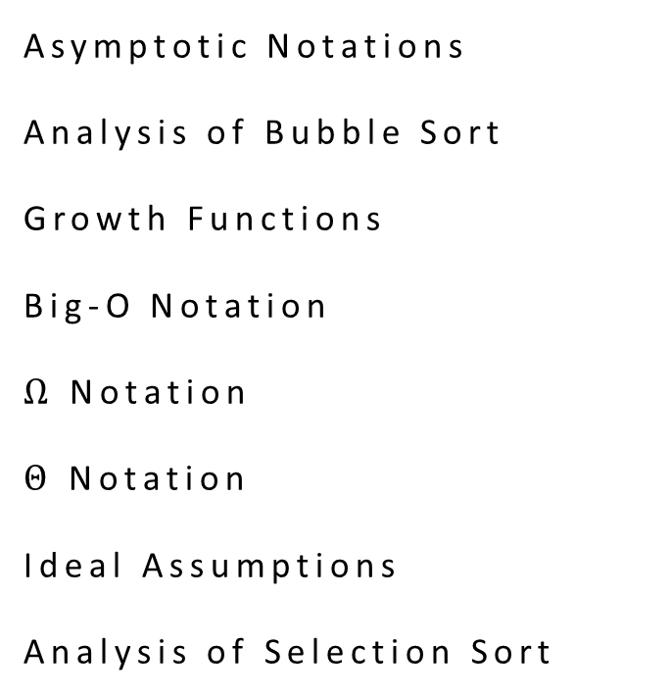
Agenda
Asymptotic Notations
Analysis of Bubble Sort
Growth Functions
Big-O Notation
$Ω$ Notation
$Θ$ Notation
Ideal Assumptions
Analysis of Selection Sort

Slide 3
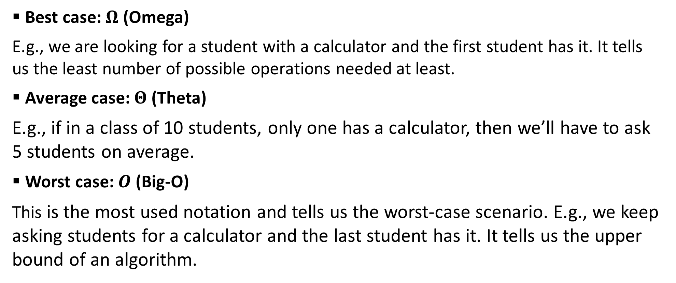
Sample 2
Asymptotic Notations
Best case: $Ω$ (Omega)
E.g., we are looking for a student with a calculator and the first student has it. It tells us the least number of possible operations needed at least.
Average case: $Θ$ (Theta)
E.g., if in a class of 10 students, only one has a calculator, then we’ll have to ask 5 students on average.
Worst case: $O$ (Big-O)
This is the most used notation and tells us the worst-case scenario. E.g., we keep asking students for a calculator and the last student has it. It tells us the upper bound of an algorithm.

Slide 4
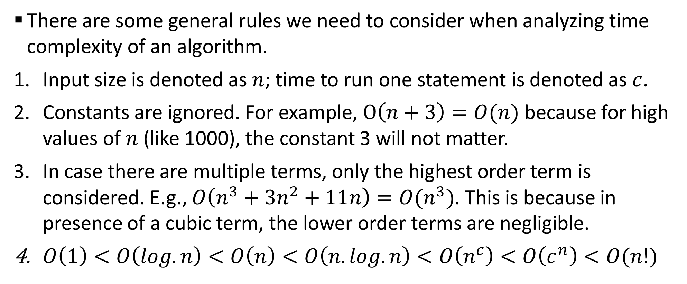
Sample 2
Asymptotic Notations
There are some general rules we need to consider when analyzing time complexity of an algorithm.
Input size is denoted as $n$; time to run one statement is denoted as $c$.
Constants are ignored. For example, $O\left(n+3\right)=O(n)$ because for high values of $n$ (like 1000), the constant 3 will not matter.
In case there are multiple terms, only the highest order term is considered. E.g., $O\left(n^{3}+3n^{2}+11n\right)=O(n^{3})$. This is because in presence of a cubic term, the lower order terms are negligible.
$O\left(1\right)<O\left(log.n\right)<O\left(n\right)<O\left(n.log.n\right)<O\left(n^{c}\right)<O\left(c^{n}\right)<O(n!)$

Slide 5
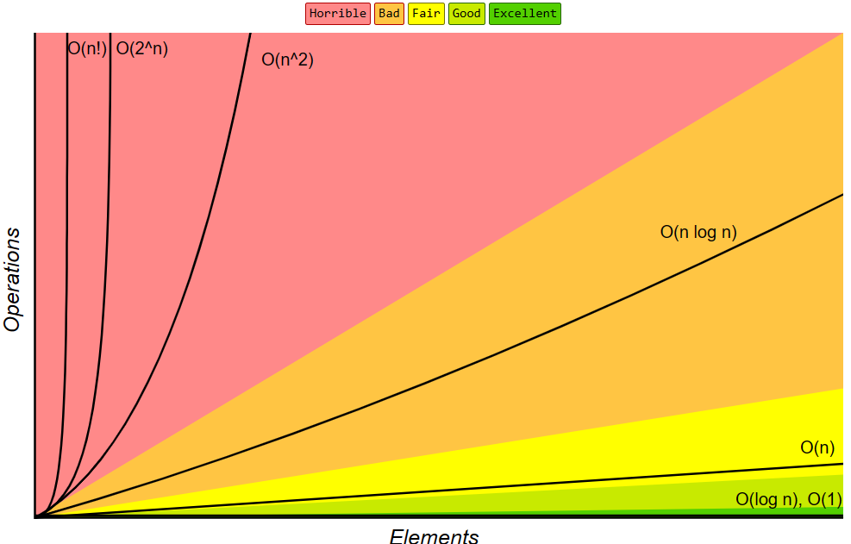
Sample 2
Asymptotic Notations

Slide 6
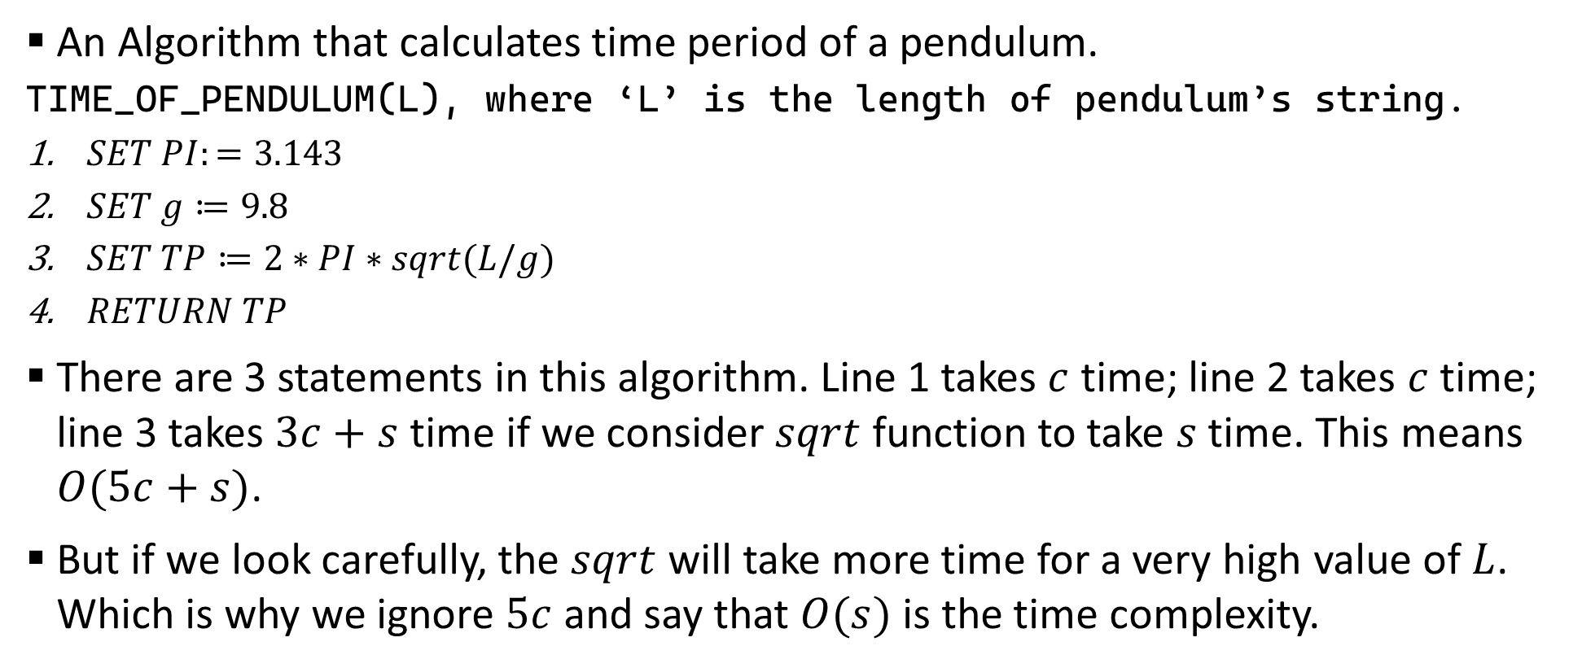
Sample 2
Examples
An Algorithm that calculates time period of a pendulum.
TIME_OF_PENDULUM(L), where ‘L’ is the length of pendulum’s string.
$SET PI:=3.143$
$SET g≔9.8$
$SET TP≔2∗PI∗sqrt(L/g)$
$RETURN TP$
There are 3 statements in this algorithm. Line 1 takes $c$ time; line 2 takes $c$ time; line 3 takes $3c+s$ time if we consider $sqrt$ function to take $s$ time. This means $O(5c+s)$.
But if we look carefully, the $sqrt$ will take more time for a very high value of $L$. Which is why we ignore $5c$ and say that $O(s)$ is the time complexity.

Slide 7
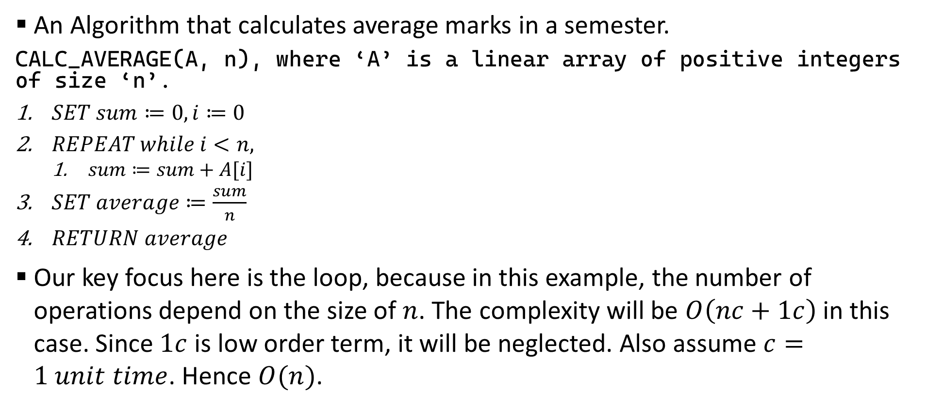
Sample 2
Examples
An Algorithm that calculates average marks in a semester.
CALC_AVERAGE(A, n), where ‘A’ is a linear array of positive integers of size ‘n’.
$SET sum≔0, i≔0$
$REPEAT while i<n,$
$sum≔sum+A[i]$
$SET average≔\frac{sum}{n}$
$RETURN average$
Our key focus here is the loop, because in this example, the number of operations depend on the size of $n$. The complexity will be $O\left(nc+1c\right)$ in this case. Since $1c$ is low order term, it will be neglected. Also assume $c=1 unit time$. Hence $O(n)$.

Slide 8
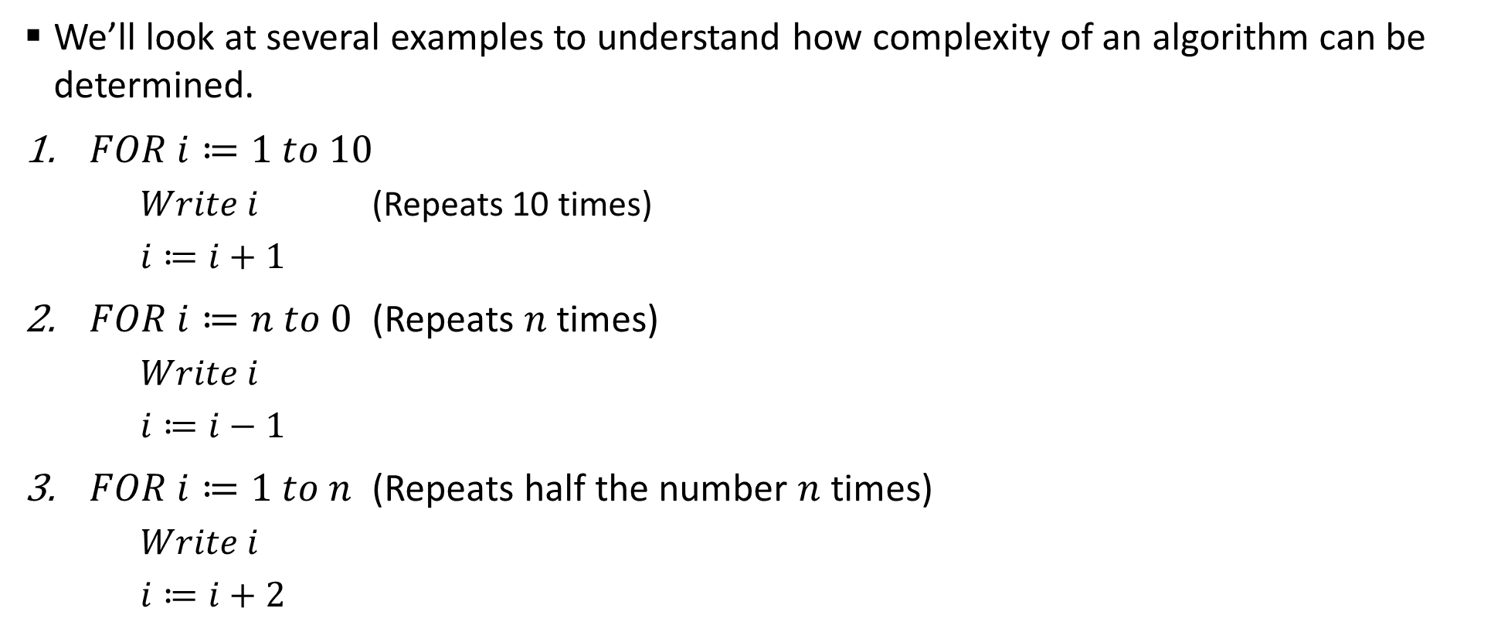
Sample 2
How to Calculate?
We’ll look at several examples to understand how complexity of an algorithm can be determined.
$FOR i≔1 to 10$
$Write i$ (Repeats 10 times)
$i≔i+1$
$FOR i≔n to 0$ (Repeats $n$ times)
$Write i$
$i≔i−1$
$FOR i≔1 to n$ (Repeats half the number $n$ times)
$Write i$
$i≔i+2$

Slide 9
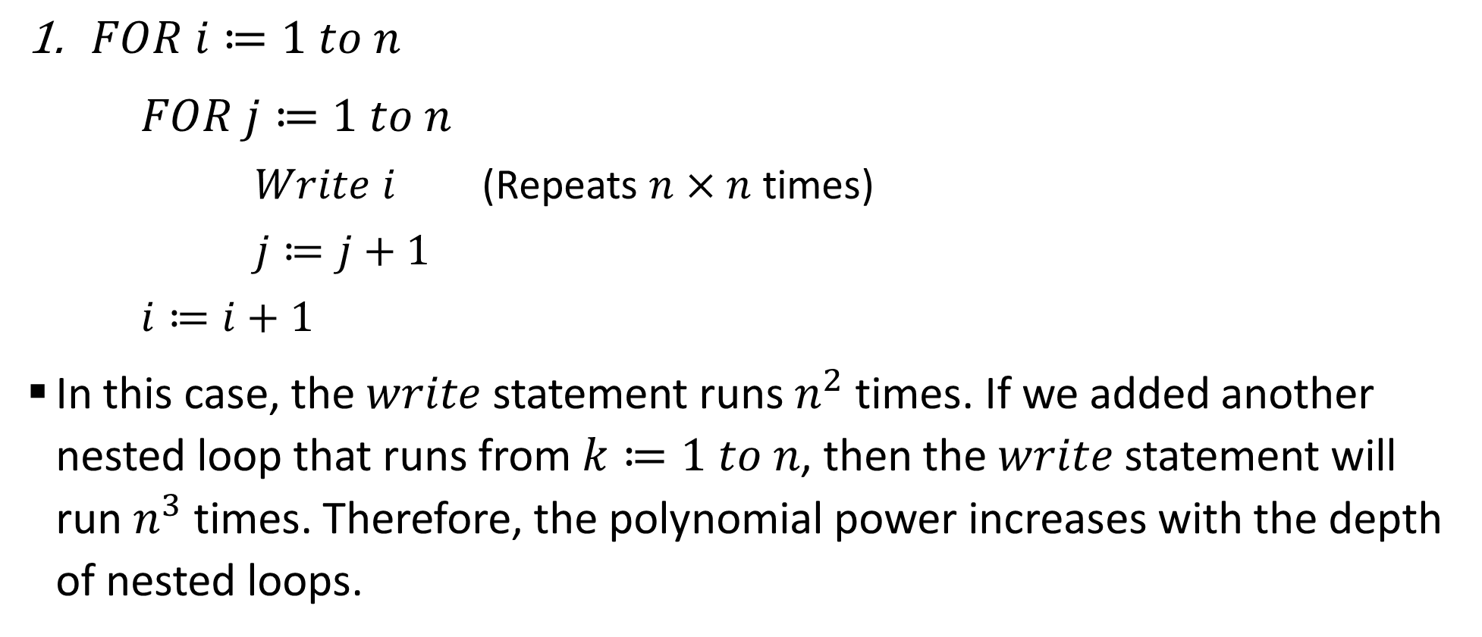
Sample 2
How to Calculate?
$FOR i≔1 to n$
$FOR j≔1 to n$
$Write i$ (Repeats $n×n$ times)
$j≔j+1$
$i≔i+1$
In this case, the $write$ statement runs $n^{2}$ times. If we added another nested loop that runs from $k≔1 to n$, then the $write$ statement will run $n^{3}$ times. Therefore, the polynomial power increases with the depth of nested loops.

Slide 10
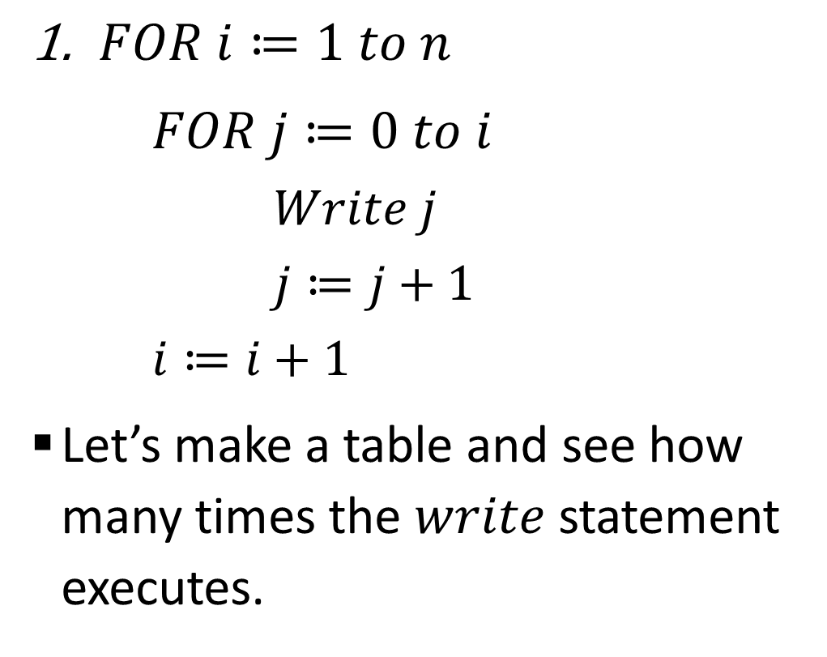
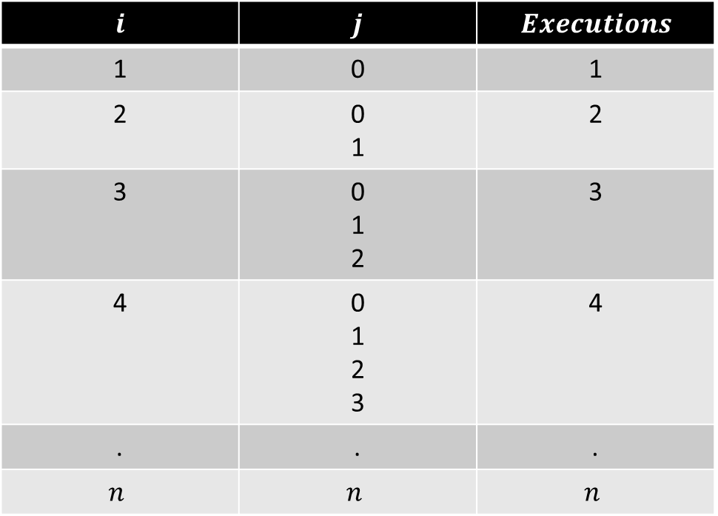
Sample 2
How to Calculate?
$FOR i≔1 to n$
$FOR j≔0 to i$
$Write j$
$j≔j+1$
$i≔i+1$
Let’s make a table and see how many times the $write$ statement executes.
$$i$$ | $$j$$ | $$Executions$$
1 | 0 | 1
2 | 0 1 | 2
3 | 0 1 2 | 3
4 | 0 1 2 3 | 4
. | . | .
$$n$$ | $$n$$ | $$n$$

Slide 11
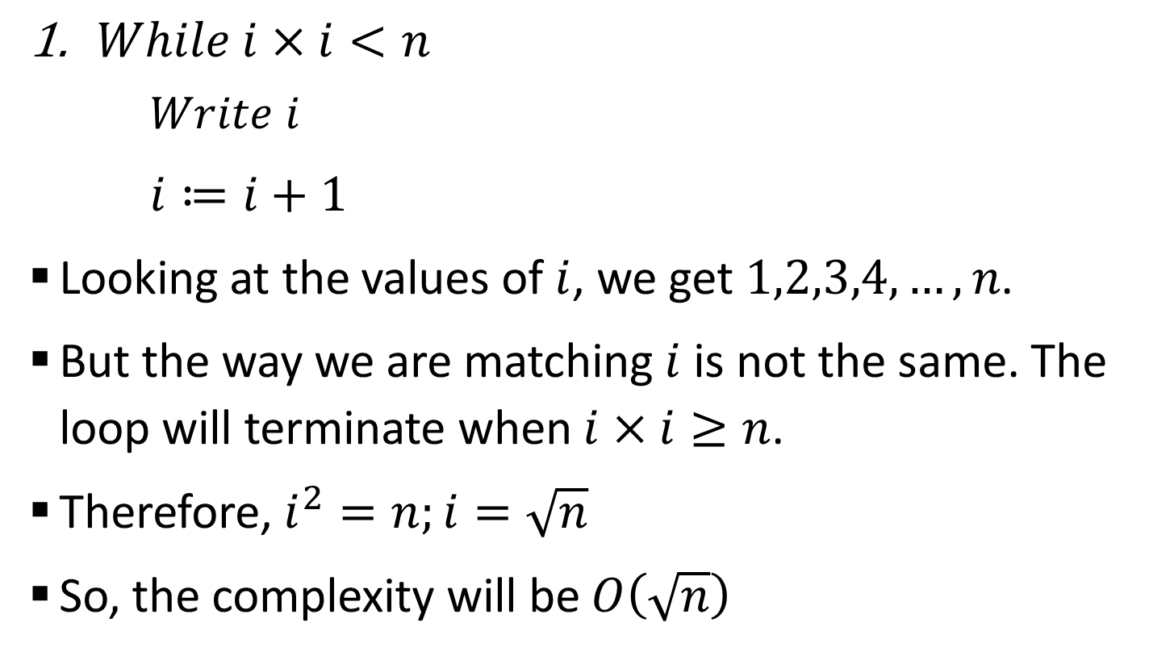
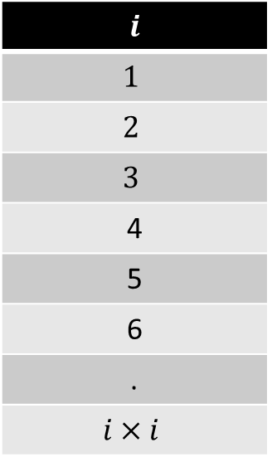
Sample 2
How to Calculate?
$While i×i<n$
$Write i$
$i≔i+1$
Looking at the values of $i$, we get $1,2,3,4,…,n$.
But the way we are matching $i$ is not the same. The loop will terminate when $i×i≥n$.
Therefore, $i^{2}=n;i=\sqrt{n}$
So, the complexity will be $O\left(\sqrt{n}\right)$
$$i$$
$$1$$
$$2$$
$$3$$
4
5
6
.
$$i×i$$
Notes:
At this point, recommend the video on time complexity by Abdul Bari: https://www.youtube.com/watch?v=9SgLBjXqwd4&t=1s

Slide 12
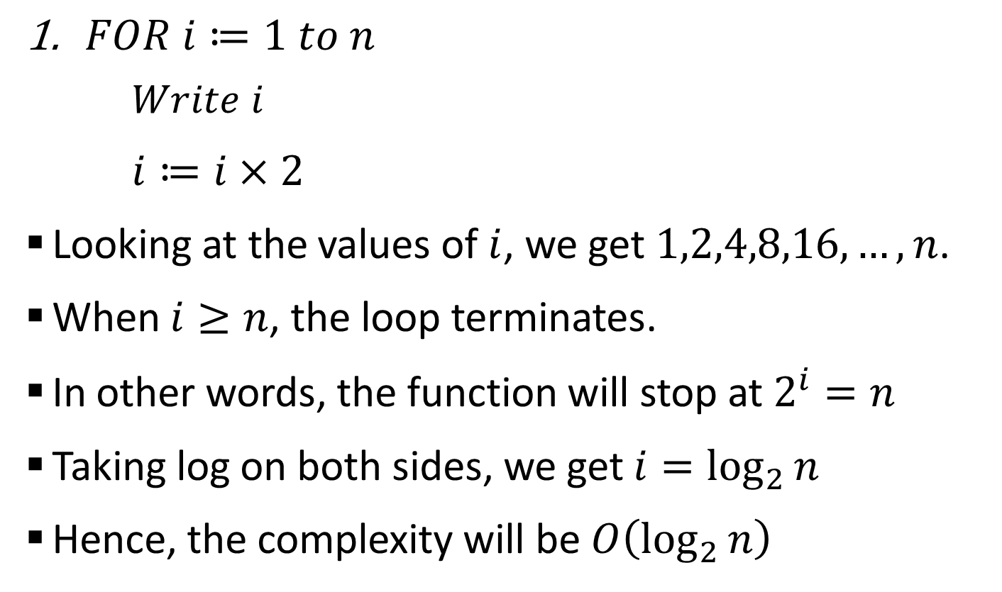
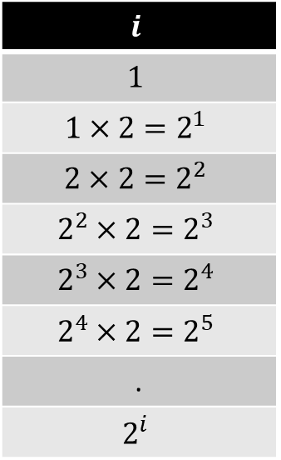
Sample 2
How to Calculate?
$FOR i≔1 to n$
$Write i$
$i≔i×2$
Looking at the values of $i$, we get $1,2,4,8,16,…,n$.
When $i≥n$, the loop terminates.
In other words, the function will stop at $2^{i}=n$
Taking log on both sides, we get $i=\log_{2}{n}$
Hence, the complexity will be $O\left(\log_{2}{n}\right)$
$$i$$
$$1$$
$$1×2=2^{1}$$
$$2×2=2^{2}$$
$$2^{2}×2=2^{3}$$
$$2^{3}×2=2^{4}$$
$$2^{4}×2=2^{5}$$
.
$$2^{i}$$

Slide 13
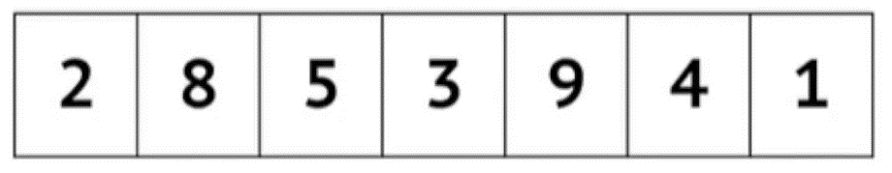
Sample 2
Bubble Sort
Bubble sort traverses the array, visits each element and matches it with its next neighbour. If the order is incorrect then the elements are swapped.
This way, in each iteration a sorted partition is formed on the right side and unsorted elements remain on the left side.
The following animation simulates how an array is sorted using Bubble sort algorithm.
Notes:
Animation credit: Michael Sambol

Slide 14
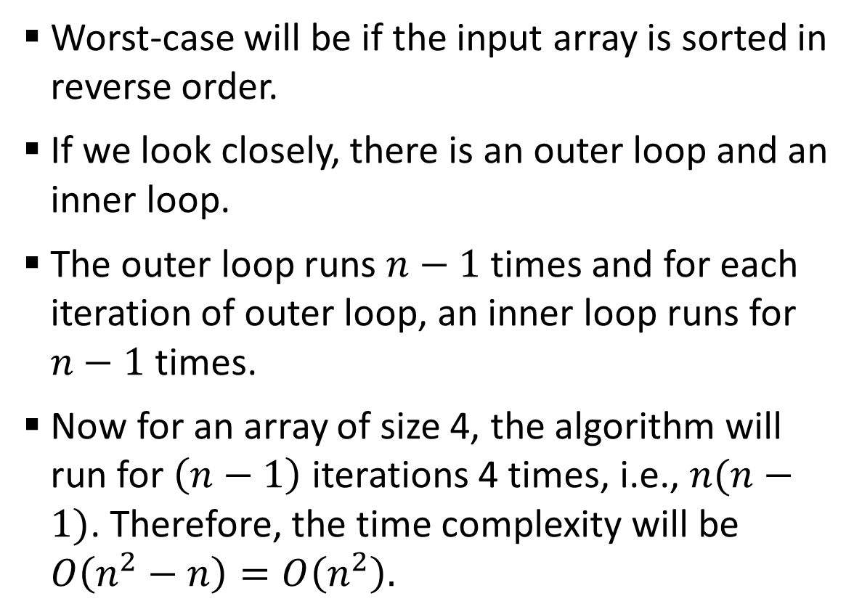
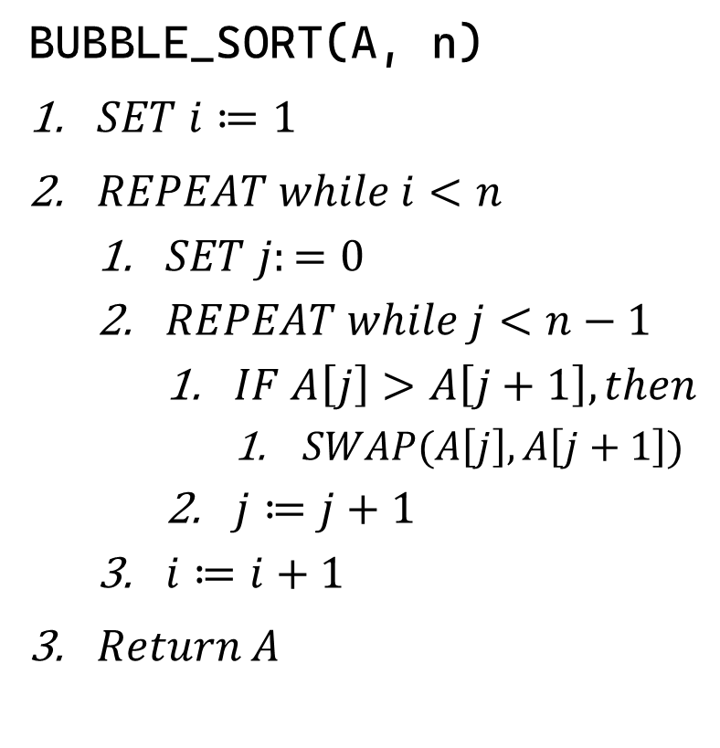
Sample 2
Analysis of Bubble Sort
Worst-case will be if the input array is sorted in reverse order.
If we look closely, there is an outer loop and an inner loop.
The outer loop runs $n−1$ times and for each iteration of outer loop, an inner loop runs for $n−1$ times.
Now for an array of size 4, the algorithm will run for $\left(n−1\right)$ iterations 4 times, i.e., $n(n−1)$. Therefore, the time complexity will be $O\left(n^{2}−n\right)=O\left(n^{2}\right).$
BUBBLE_SORT(A, n)
$SET i≔1$
$REPEAT while i<n$
$SET j:=0$
$REPEAT while j<n−1$
$IF A\left[j\right]>A\left[j+1\right], then$
$SWAP(A\left[j\right], A\left[j+1\right])$
$j≔j+1$
$i≔i+1$
$Return A$
Notes:
The swap operation takes 3 statements, thus a constant. Same goes with other statements.

Slide 15
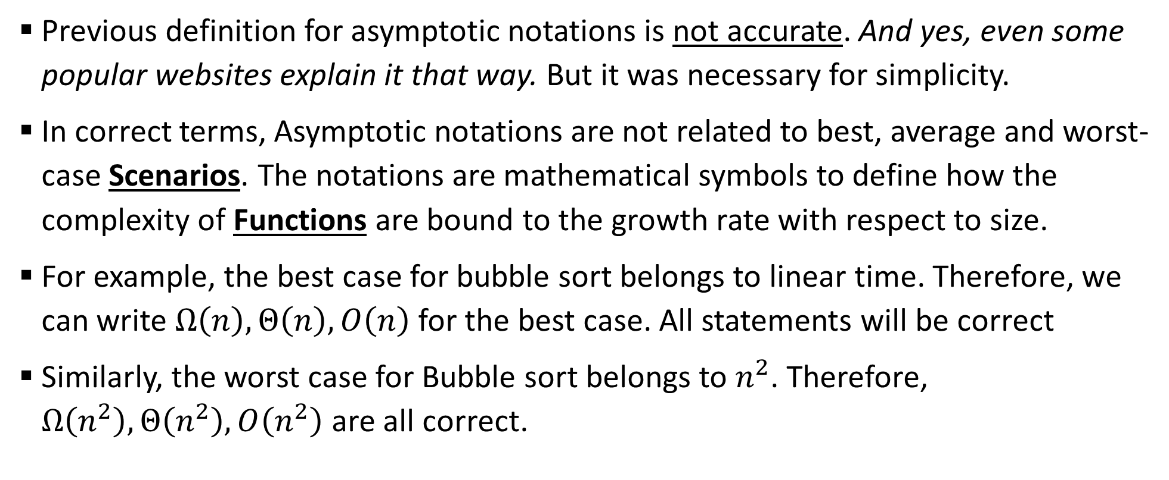
Sample 2
Asymptotic Notations
Previous definition for asymptotic notations is not accurate. And yes, even some popular websites explain it that way. But it was necessary for simplicity.
In correct terms, Asymptotic notations are not related to best, average and worst-case Scenarios. The notations are mathematical symbols to define how the complexity of Functions are bound to the growth rate with respect to size.
For example, the best case for bubble sort belongs to linear time. Therefore, we can write $Ω\left(n\right),Θ\left(n\right),O\left(n\right)$ for the best case. All statements will be correct
Similarly, the worst case for Bubble sort belongs to $n^{2}$. Therefore, $Ω\left(n^{2}\right),Θ\left(n^{2}\right),O\left(n^{2}\right)$ are all correct.

Slide 16
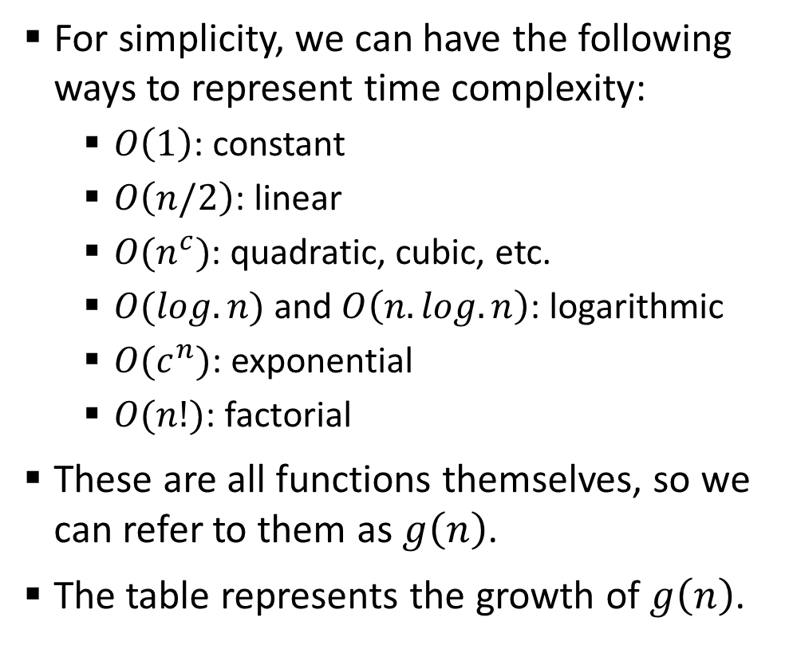
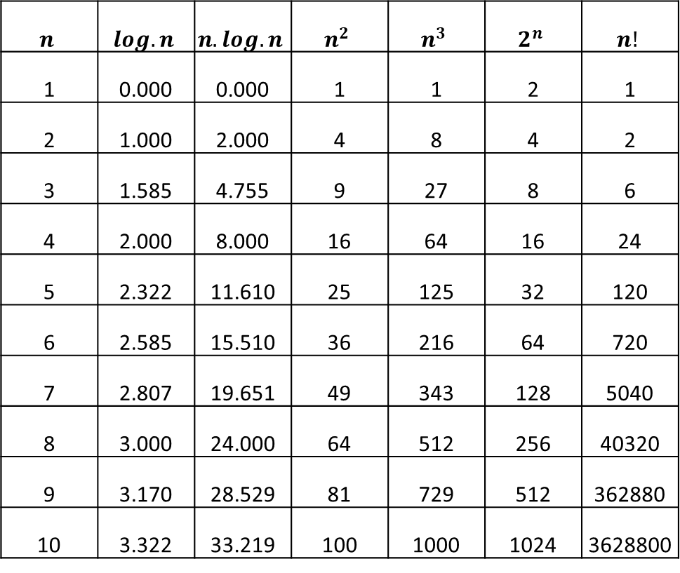
Sample 2
Growth Functions
For simplicity, we can have the following ways to represent time complexity:
$O\left(1\right)$: constant
$O\left(n/2\right)$: linear
$O(n^{c})$: quadratic, cubic, etc.
$O(log.n)$ and $O\left(n.log.n\right)$: logarithmic
$O(c^{n})$: exponential
$O(n!)$: factorial
These are all functions themselves, so we can refer to them as $g\left(n\right)$.
The table represents the growth of $g\left(n\right)$.
$$n$$ | $$log.n$$ | $$n.log.n$$ | $$n^{2}$$ | $$n^{3}$$ | $$2^{n}$$ | $$n!$$
1 | 0.000 | 0.000 | 1 | 1 | 2 | 1
2 | 1.000 | 2.000 | 4 | 8 | 4 | 2
3 | 1.585 | 4.755 | 9 | 27 | 8 | 6
4 | 2.000 | 8.000 | 16 | 64 | 16 | 24
5 | 2.322 | 11.610 | 25 | 125 | 32 | 120
6 | 2.585 | 15.510 | 36 | 216 | 64 | 720
7 | 2.807 | 19.651 | 49 | 343 | 128 | 5040
8 | 3.000 | 24.000 | 64 | 512 | 256 | 40320
9 | 3.170 | 28.529 | 81 | 729 | 512 | 362880
10 | 3.322 | 33.219 | 100 | 1000 | 1024 | 3628800

Slide 17
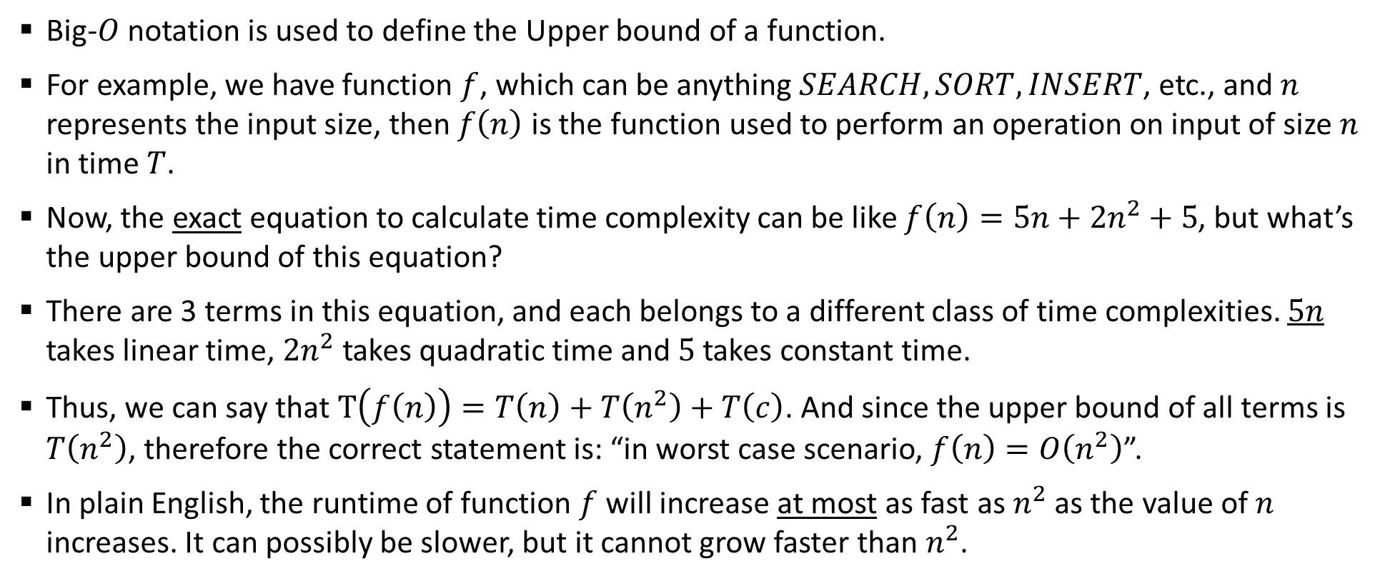
Sample 2
Big-O Notation
Big-$O$ notation is used to define the Upper bound of a function.
For example, we have function $f$, which can be anything $SEARCH,SORT,INSERT$, etc., and $n$ represents the input size, then $f\left(n\right)$ is the function used to perform an operation on input of size $n$ in time $T$.
Now, the exact equation to calculate time complexity can be like $f\left(n\right)=5n+{2n}^{2}+5$, but what’s the upper bound of this equation?
There are 3 terms in this equation, and each belongs to a different class of time complexities. $5n$ takes linear time, $2n^{2}$ takes quadratic time and $5$ takes constant time.
Thus, we can say that $T\left(f\left(n\right)\right)=T\left(n\right)+T\left(n^{2}\right)+T\left(c\right)$. And since the upper bound of all terms is $T\left(n^{2}\right)$, therefore the correct statement is: “in worst case scenario, $f\left(n\right)=O\left(n^{2}\right)$”.
In plain English, the runtime of function $f$ will increase at most as fast as $n^{2}$ as the value of $n$ increases. It can possibly be slower, but it cannot grow faster than $n^{2}$.

Slide 18
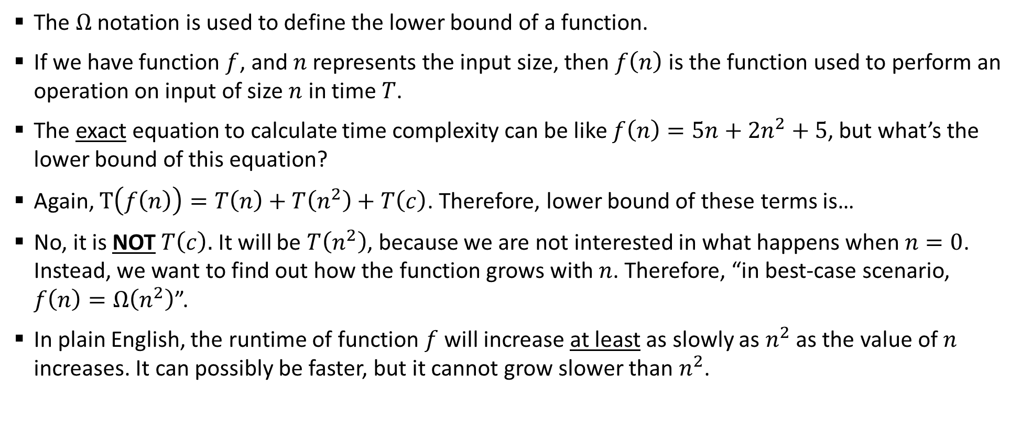
Sample 2
$Ω$ Notation
The $Ω$ notation is used to define the lower bound of a function.
If we have function $f$, and $n$ represents the input size, then $f\left(n\right)$ is the function used to perform an operation on input of size $n$ in time $T$.
The exact equation to calculate time complexity can be like $f\left(n\right)=5n+{2n}^{2}+5$, but what’s the lower bound of this equation?
Again, $T\left(f\left(n\right)\right)=T\left(n\right)+T\left(n^{2}\right)+T\left(c\right)$. Therefore, lower bound of these terms is…
No, it is NOT $T\left(c\right).$ It will be $T\left(n^{2}\right)$, because we are not interested in what happens when $n=0$. Instead, we want to find out how the function grows with $n$. Therefore, “in best-case scenario, $f\left(n\right)=Ω\left(n^{2}\right)$”.
In plain English, the runtime of function $f$ will increase at least as slowly as $n^{2}$ as the value of $n$ increases. It can possibly be faster, but it cannot grow slower than $n^{2}$.

Slide 19
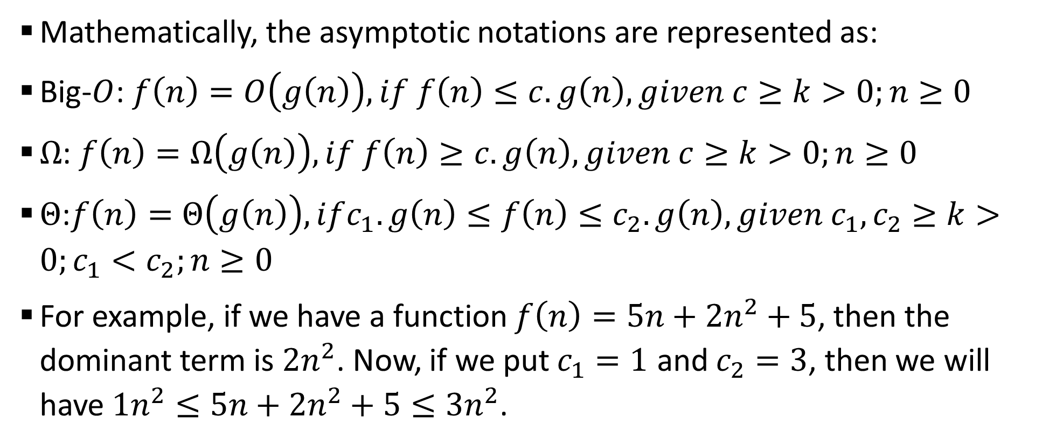
Sample 2
$Θ$ Notation
Mathematically, the asymptotic notations are represented as:
Big-$O$: $f\left(n\right)=O\left(g\left(n\right)\right), if f\left(n\right)≤c.g\left(n\right), given c≥k>0;n≥0$
$Ω$: $f\left(n\right)=Ω\left(g\left(n\right)\right),if f\left(n\right)≥c.g\left(n\right), given c≥k>0;n≥0$
$Θ$:$f\left(n\right)=Θ\left(g\left(n\right)\right),ifc_{1}.g\left(n\right)≤f\left(n\right)≤c_{2}.g\left(n\right), given c_{1},c_{2}≥k>0;c_{1}<c_{2};n≥0$
For example, if we have a function $f\left(n\right)=5n+{2n}^{2}+5$, then the dominant term is ${2n}^{2}$. Now, if we put $c_{1}=1$ and $c_{2}=3$, then we will have $1n^{2}≤5n+2n^{2}+5≤3n^{2}$.

Slide 20
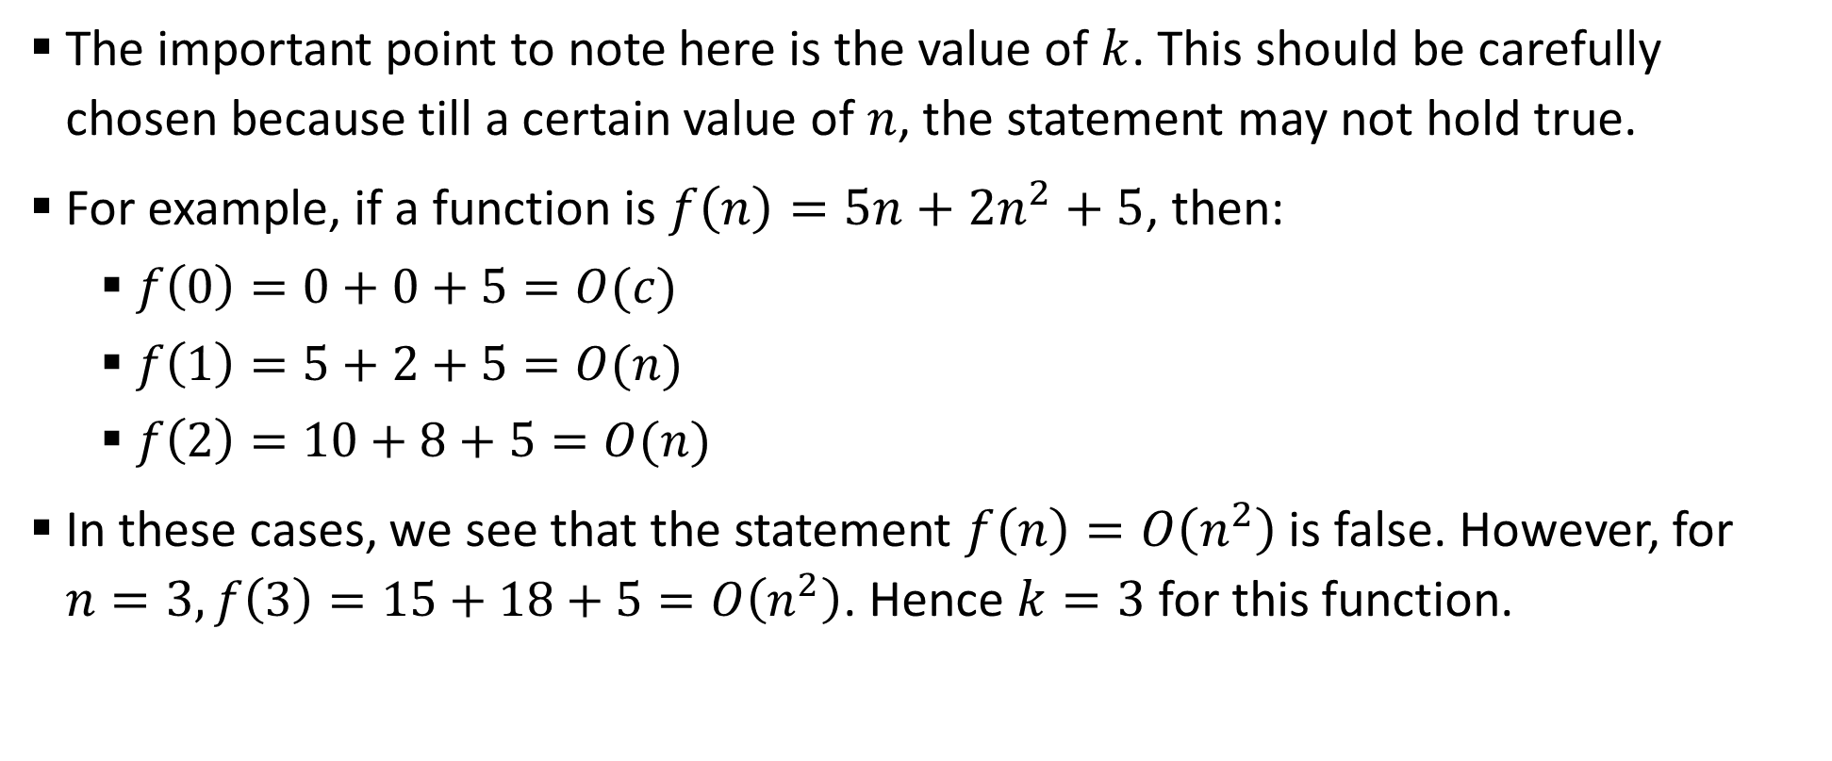
Sample 2
Asymptotic Notations
The important point to note here is the value of $k$. This should be carefully chosen because till a certain value of $n$, the statement may not hold true.
For example, if a function is $f\left(n\right)=5n+2n^{2}+5$, then:
$f\left(0\right)=0+0+5=O(c)$
$f\left(1\right)=5+2+5=O(n)$
$f\left(2\right)=10+8+5=O(n)$
In these cases, we see that the statement $f\left(n\right)=O\left(n^{2}\right)$ is false. However, for $n=3, f\left(3\right)=15+18+5=O\left(n^{2}\right)$. Hence $k=3$ for this function.
Notes:
Recommended read: Chapter 3 from “Introduction to Algorithms” by Thomas Cormen.

Slide 21
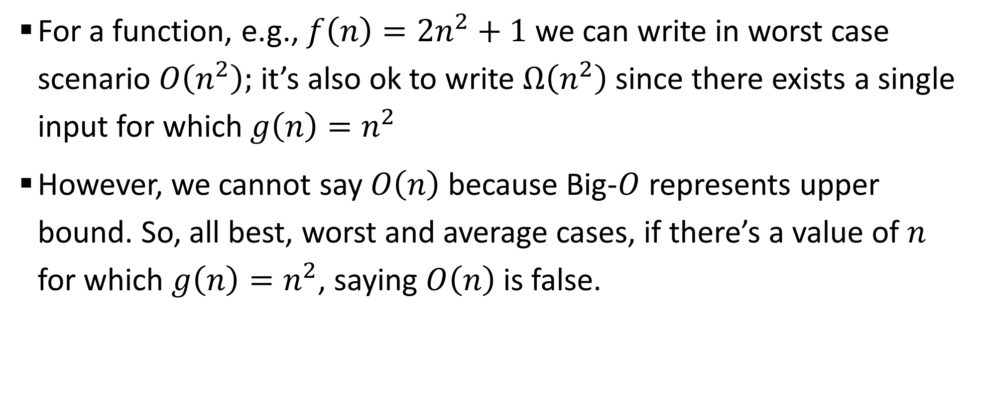
Sample 2
Asymptotic Notations
For a function, e.g., $f\left(n\right)=2n^{2}+1$ we can write in worst case scenario $O\left(n^{2}\right);$ it’s also ok to write $Ω\left(n^{2}\right)$ since there exists a single input for which $g\left(n\right)=n^{2}$
However, we cannot say $O\left(n\right)$ because Big-$O$ represents upper bound. So, all best, worst and average cases, if there’s a value of $n$ for which $g\left(n\right)=n^{2}$, saying $O\left(n\right)$ is false.

Slide 22
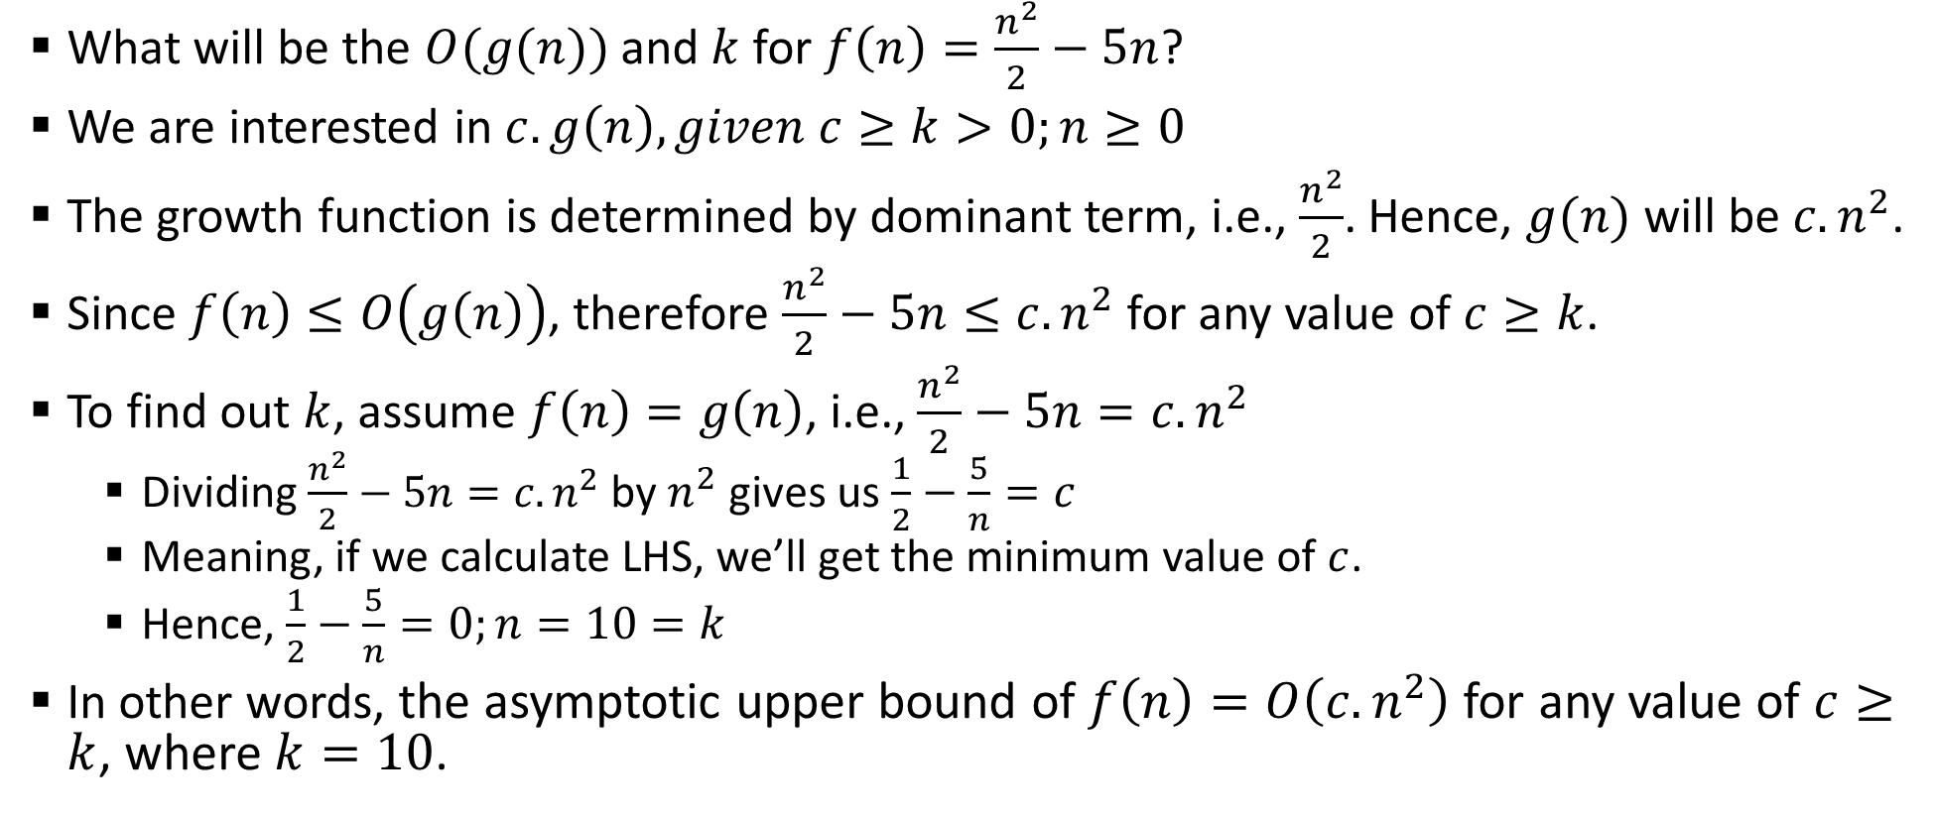
Sample 2
Exercise
What will be the $O(g(n))$ and $k$ for $f\left(n\right)=\frac{n^{2}}{2}−5n$?
We are interested in $c.g\left(n\right), given c≥k>0;n≥0$
The growth function is determined by dominant term, i.e., $\frac{n^{2}}{2}$. Hence, $g(n)$ will be $c.n^{2}$.
Since $f\left(n\right)≤O\left(g\left(n\right)\right)$, therefore $\frac{n^{2}}{2}−5n≤c.n^{2}$ for any value of $c≥k$.
To find out $k$, assume $f\left(n\right)=g\left(n\right)$, i.e., $\frac{n^{2}}{2}−5n=c.n^{2}$
Dividing $\frac{n^{2}}{2}−5n=c.n^{2}$ by $n^{2}$ gives us $\frac{1}{2}−\frac{5}{n}=c$
Meaning, if we calculate LHS, we’ll get the minimum value of $c$.
Hence, $\frac{1}{2}−\frac{5}{n}=0;n=10=k$
In other words, the asymptotic upper bound of $f\left(n\right)=O\left({c.n}^{2}\right)$ for any value of $c≥k$, where $k=10$.

Slide 23
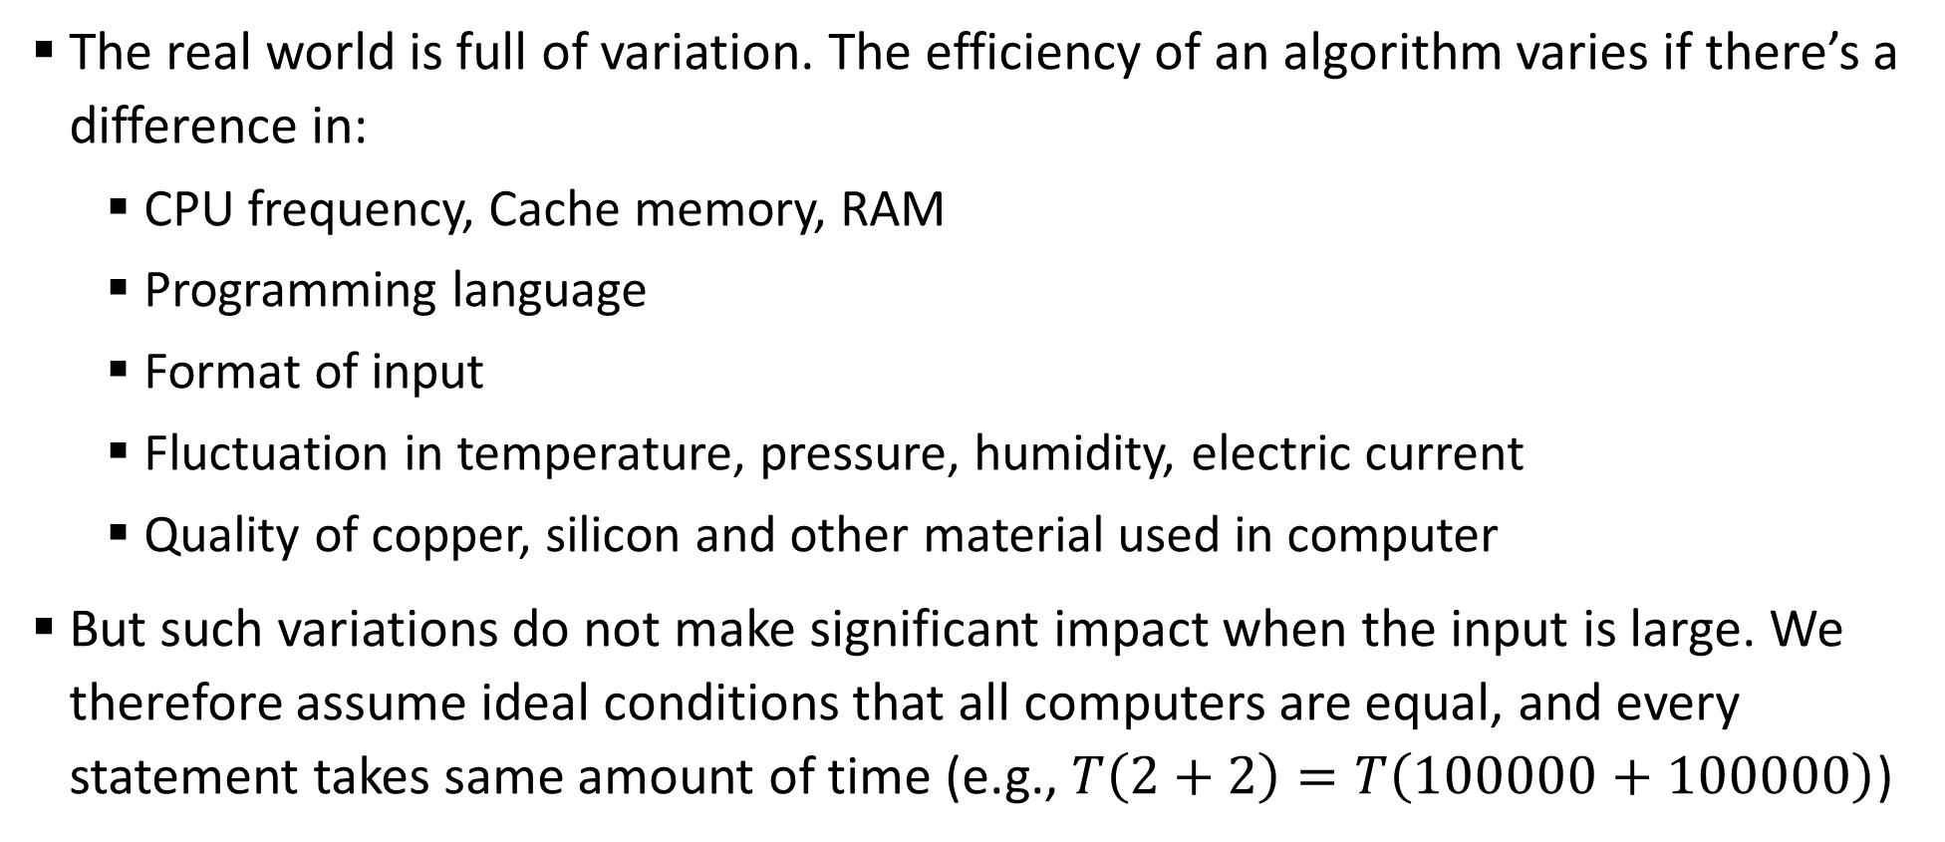
Sample 2
Ideal Assumptions
The real world is full of variation. The efficiency of an algorithm varies if there’s a difference in:
CPU frequency, Cache memory, RAM
Programming language
Format of input
Fluctuation in temperature, pressure, humidity, electric current
Quality of copper, silicon and other material used in computer
But such variations do not make significant impact when the input is large. We therefore assume ideal conditions that all computers are equal, and every statement takes same amount of time (e.g., $T\left(2+2\right)=T\left(100000+100000\right)$)

Slide 24
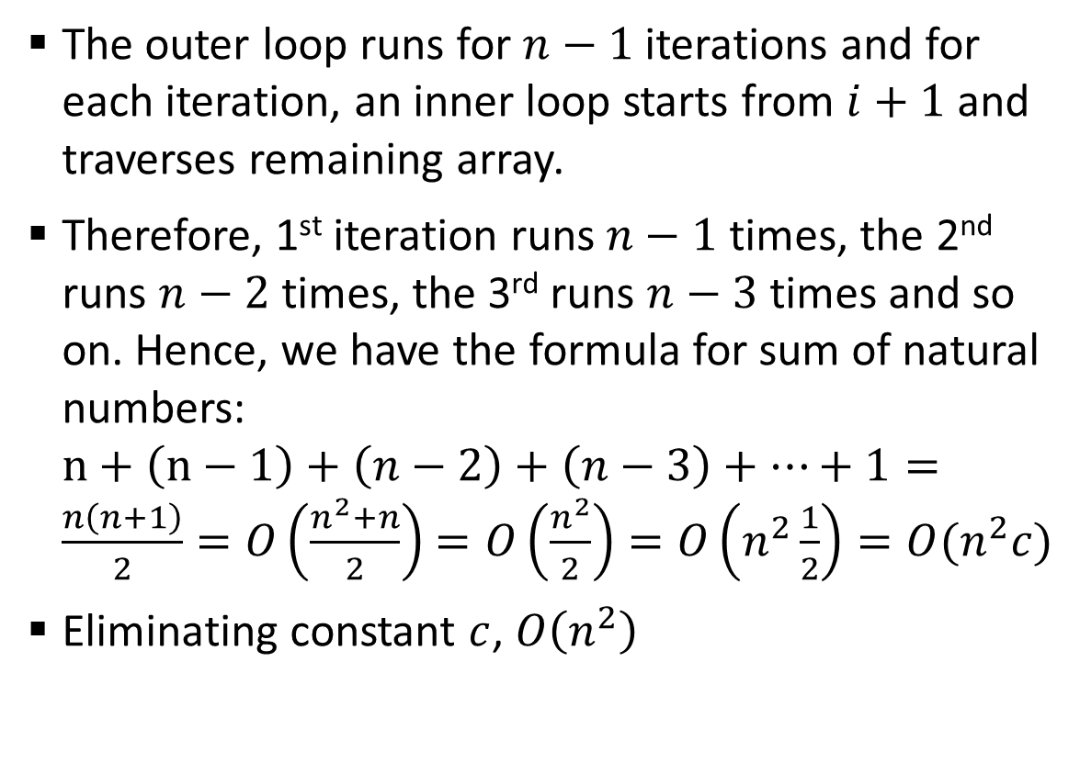
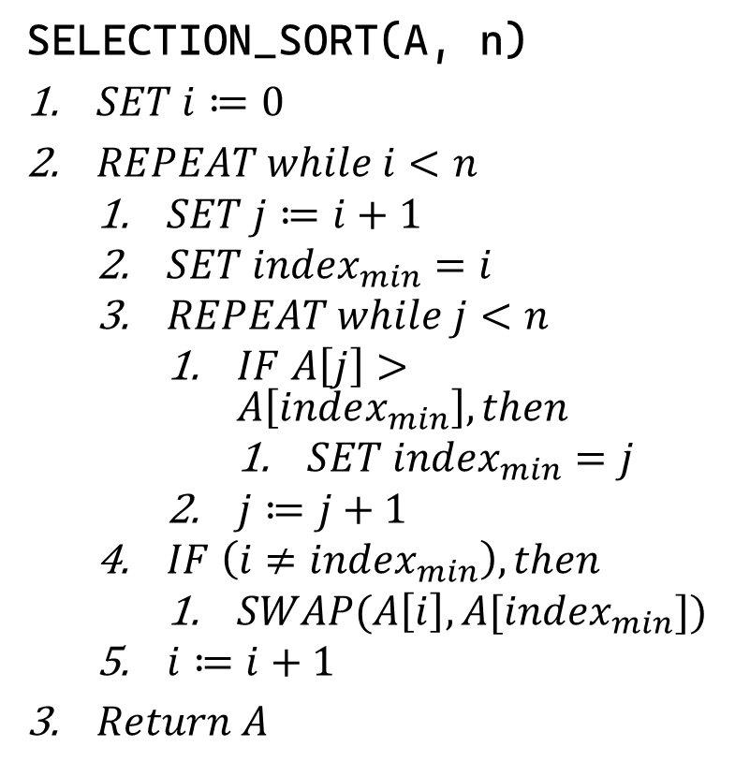
Sample 2
Analysis of Selection Sort
The outer loop runs for $n−1$ iterations and for each iteration, an inner loop starts from $i+1$ and traverses remaining array.
Therefore, 1st iteration runs $n−1$ times, the 2nd runs $n−2$ times, the 3rd runs $n−3$ times and so on. Hence, we have the formula for sum of natural numbers: $n+\left(n−1\right)+\left(n−2\right)+\left(n−3\right)+…+1=\frac{n\left(n+1\right)}{2}=O\left(\frac{n^{2}+n}{2}\right)$ $=O\left(\frac{n^{2}}{2}\right)=O\left(n^{2}\frac{1}{2}\right)=O(n^{2}c)$
Eliminating constant $c$, $O\left(n^{2}\right)$
SELECTION_SORT(A, n)
$SET i≔0$
$REPEAT while i<n$
$SET j≔i+1$
$SET index_{min}=i$
$REPEAT while j<n$
$IF A\left[j\right]>A\left[index_{min}\right], then$
$SET index_{min}=j$
$j≔j+1$
$IF \left(i≠index_{min}\right), then$
$SWAP(A\left[i\right], A[index_{min}])$
$i≔i+1$
$Return A$

Slide 25
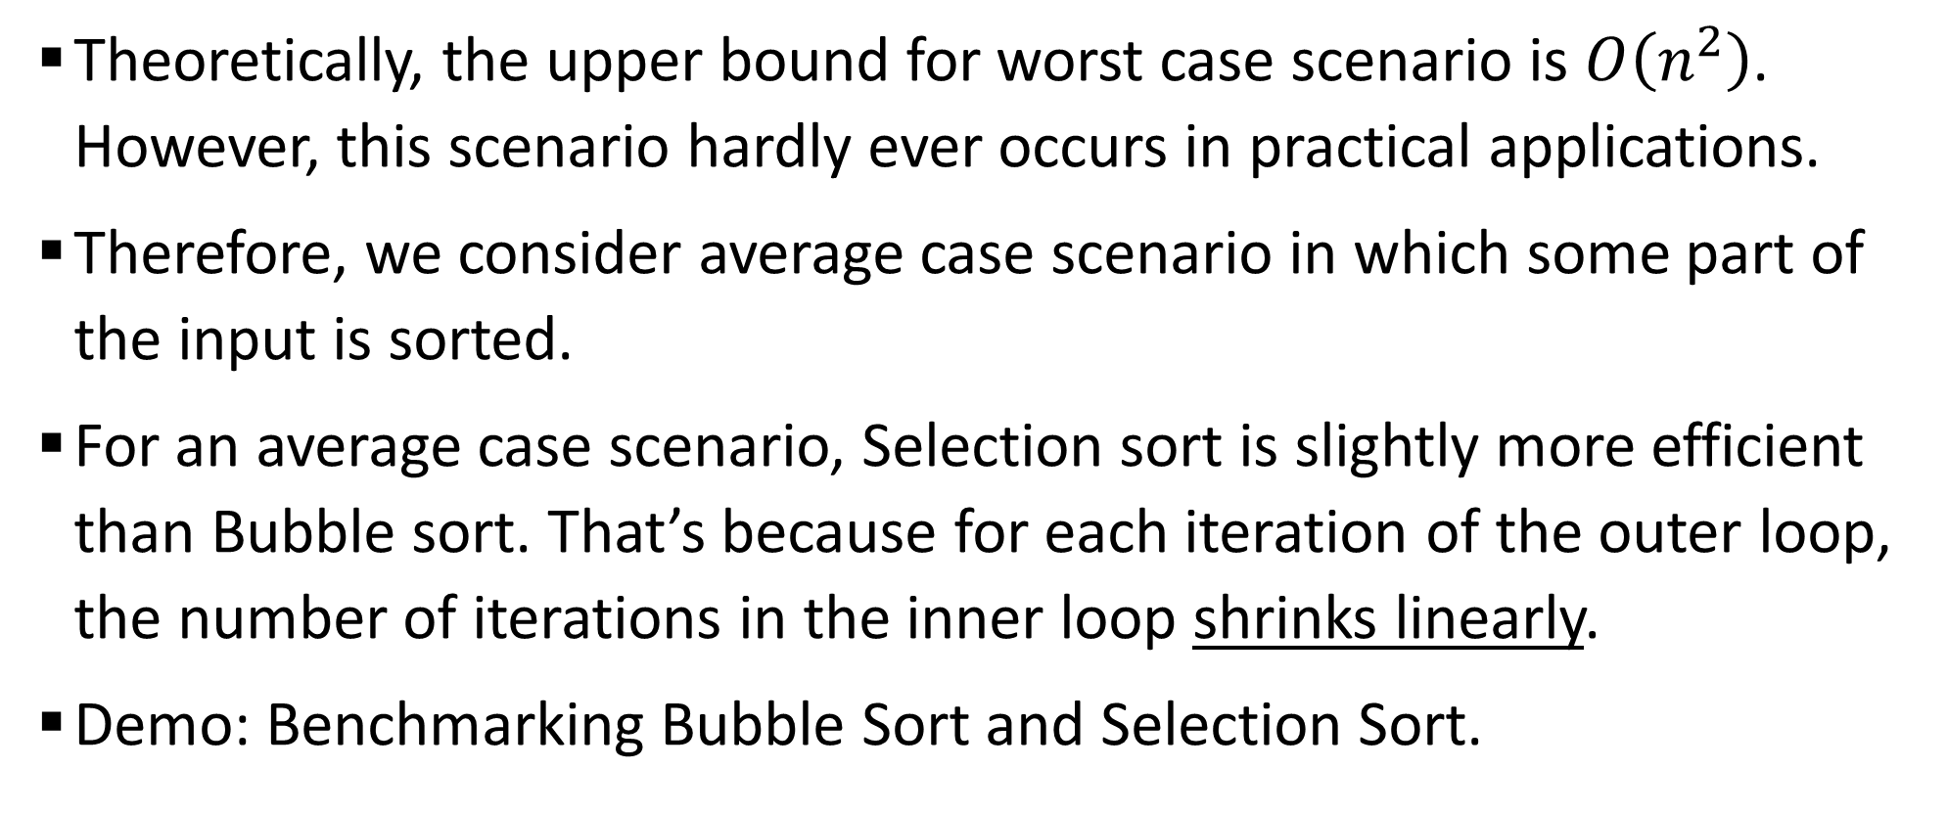
Sample 2
Analysis of Selection Sort
Theoretically, the upper bound for worst case scenario is $O\left(n^{2}\right)$. However, this scenario hardly ever occurs in practical applications.
Therefore, we consider average case scenario in which some part of the input is sorted.
For an average case scenario, Selection sort is slightly more efficient than Bubble sort. That’s because for each iteration of the outer loop, the number of iterations in the inner loop shrinks linearly.
Demo: Benchmarking Bubble Sort and Selection Sort.

Slide 26
Sample 2
Analysis of Selection Sort
AND NOW, THE FUN PART

Slide 27
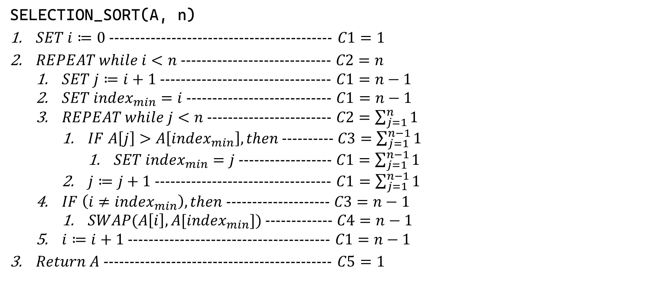
Sample 2
Analysis of Selection Sort
SELECTION_SORT(A, n)
$SET i≔0$ ------------------------------------------- $C1=1$
$REPEAT while i<n$ ----------------------------- $C2=n$
$SET j≔i+1$ --------------------------------- $C1=n−1$
$SET index_{min}=i$ ---------------------------- $C1=n−1$
$REPEAT while j<n$ ------------------------ $C2=\sum_{j=1}^{n}{1}$
$IF A\left[j\right]>A\left[index_{min}\right], then$ ---------- $C3=\sum_{j=1}^{n−1}{1}$
$SET index_{min}=j$ ------------------ $C1=\sum_{j=1}^{n−1}{1}$
$j≔j+1$ ---------------------------------- $C1=\sum_{j=1}^{n−1}{1}$
$IF \left(i≠index_{min}\right), then$ -------------------- $C3=n−1$
$SWAP(A\left[i\right], A[index_{min}])$ ------------- $C4=n−1$
$i≔i+1$ --------------------------------------- $C1=n−1$
$Return A$ -------------------------------------------- $C5=1$

Slide 28
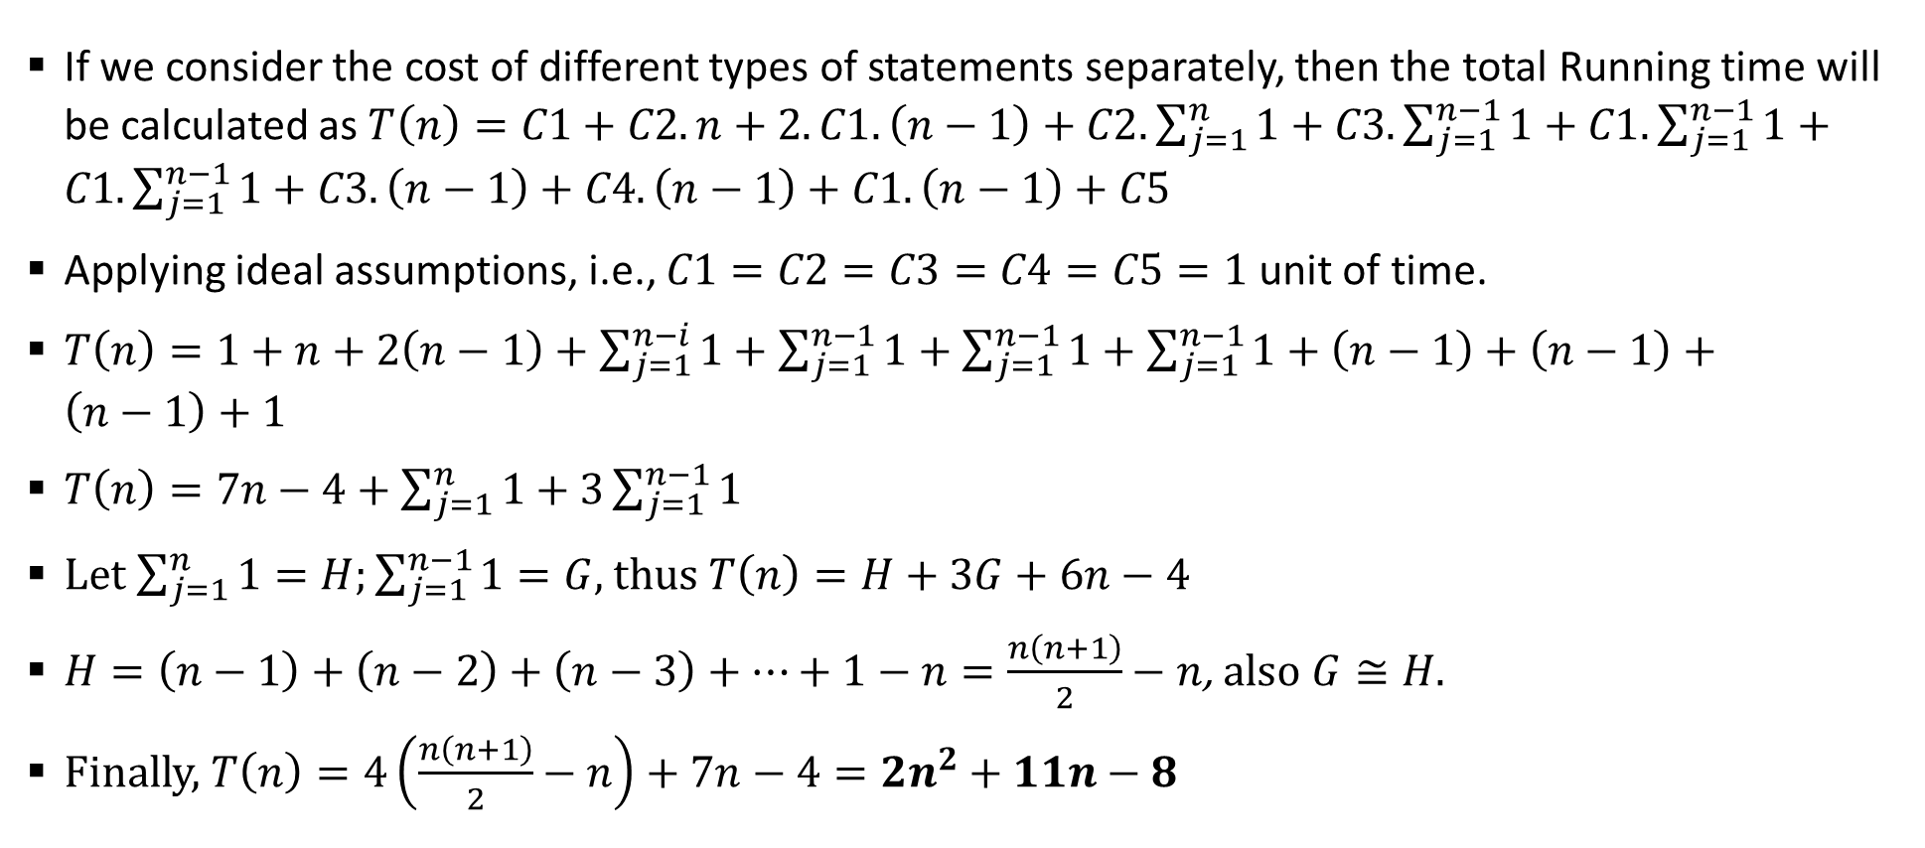
Sample 2
Analysis of Selection Sort
If we consider the cost of different types of statements separately, then the total Running time will be calculated as $T\left(n\right)=C1+C2.n+2.C1.\left(n−1\right)+C2.\sum_{j=1}^{n}{1}+C3.\sum_{j=1}^{n−1}{1}+C1.\sum_{j=1}^{n−1}{1}+C1.\sum_{j=1}^{n−1}{1}+C3.\left(n−1\right)+C4.\left(n−1\right)+C1.\left(n−1\right)+C5$
Applying ideal assumptions, i.e., $C1=C2=C3=C4=C5=1$ unit of time.
$T\left(n\right)=1+n+2\left(n−1\right)+\sum_{j=1}^{n−i}{1}+\sum_{j=1}^{n−1}{1}+\sum_{j=1}^{n−1}{1}+\sum_{j=1}^{n−1}{1}+\left(n−1\right)+\left(n−1\right)+\left(n−1\right)+1$
$T\left(n\right)=7n−4+\sum_{j=1}^{n}{1}+3\sum_{j=1}^{n−1}{1}$
Let $\sum_{j=1}^{n}{1}=H;\sum_{j=1}^{n−1}{1}=G$, thus $T\left(n\right)=H+3G+6n−4$
$H=\left(n−1\right)+\left(n−2\right)+\left(n−3\right)+…+1−n=\frac{n\left(n+1\right)}{2}−n$, also $G≅H$.
Finally, $T\left(n\right)=4\left(\frac{n\left(n+1\right)}{2}−n\right)+7n−4=2n^{2}+11n−8$

Slide 29
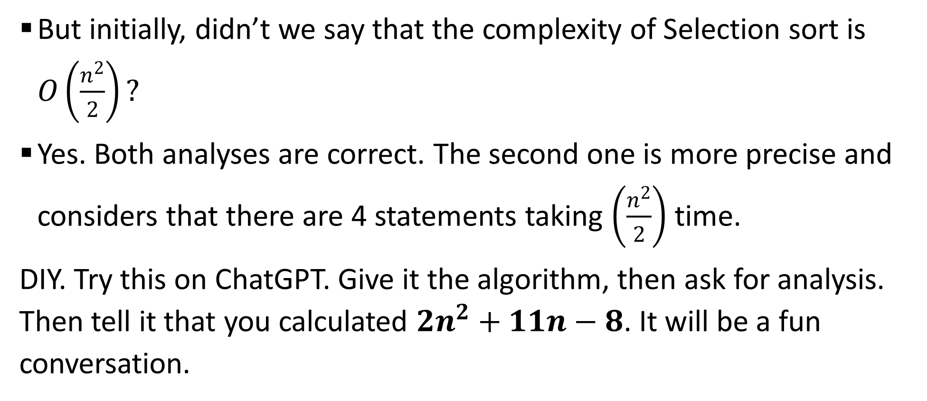
Sample 2
Analysis of Selection Sort
But initially, didn’t we say that the complexity of Selection sort is $O\left(\frac{n^{2}}{2}\right)?$
Yes. Both analyses are correct. The second one is more precise and considers that there are 4 statements taking $\left(\frac{n^{2}}{2}\right)$ time.
DIY. Try this on ChatGPT. Give it the algorithm, then ask for analysis. Then tell it that you calculated $2n^{2}+11n−8$. It will be a fun conversation.

Slide 30
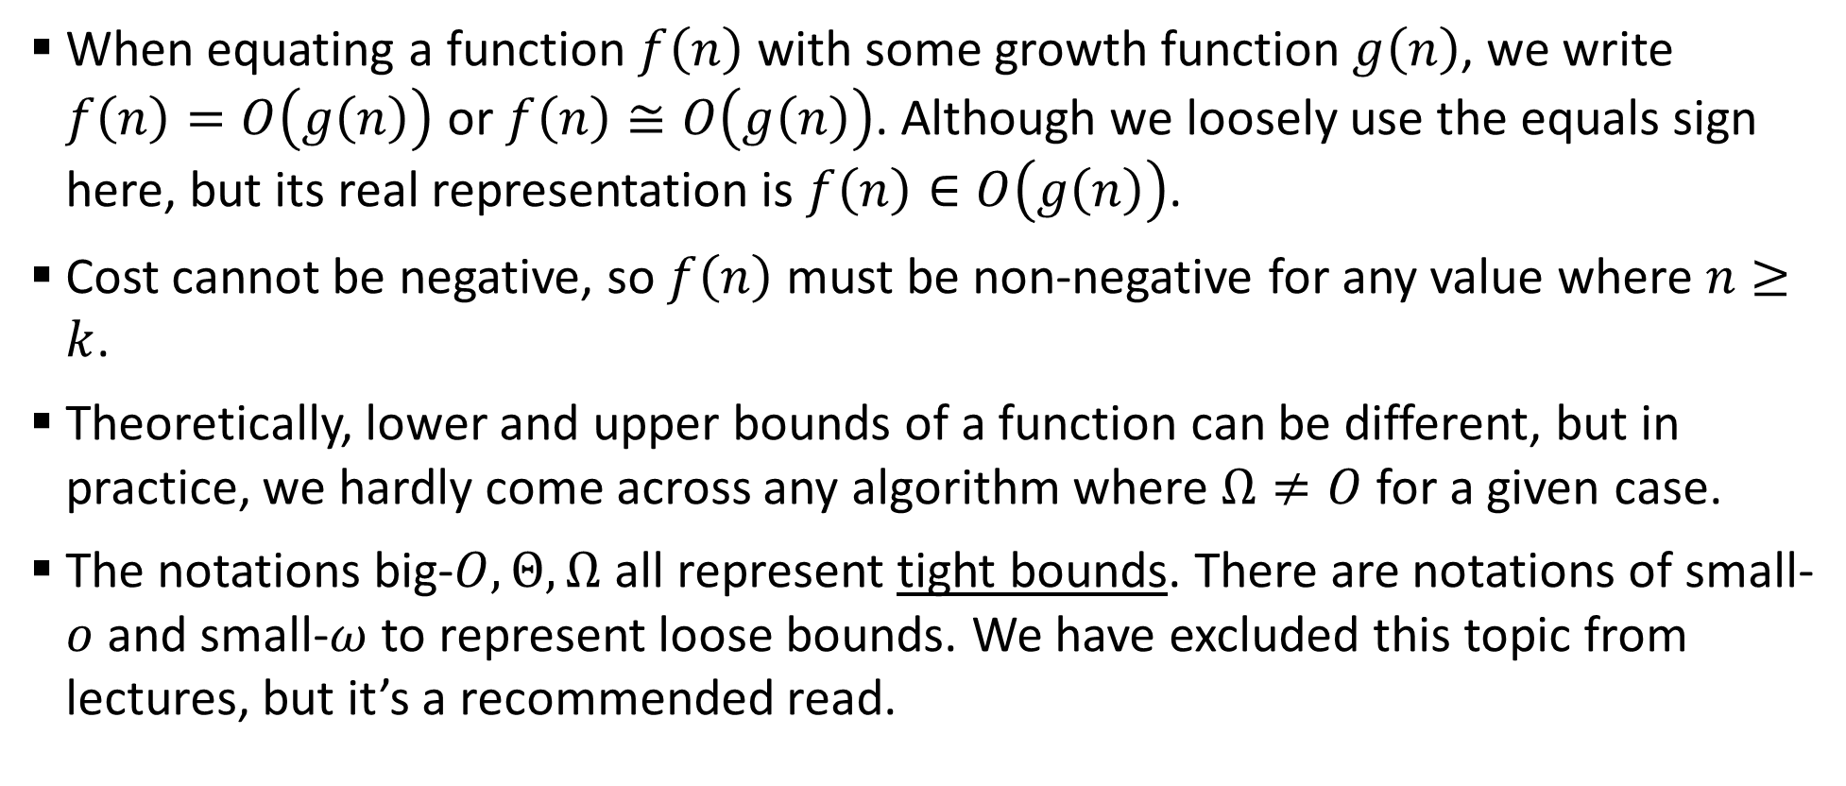
Sample 2
Important Notes!
When equating a function $f\left(n\right)$ with some growth function $g\left(n\right)$, we write $f\left(n\right)=O\left(g\left(n\right)\right)$ or $f\left(n\right)≅O\left(g\left(n\right)\right)$. Although we loosely use the equals sign here, but its real representation is $f\left(n\right)∈O\left(g\left(n\right)\right)$.
Cost cannot be negative, so $f\left(n\right)$ must be non-negative for any value where $n≥k$.
Theoretically, lower and upper bounds of a function can be different, but in practice, we hardly come across any algorithm where $Ω≠O$ for a given case.
The notations big-$O,Θ,Ω$ all represent tight bounds. There are notations of small-$o$ and small-$ω$ to represent loose bounds. We have excluded this topic from lectures, but it’s a recommended read.

Slide 31



THANK YOU
Owais Hussain
+92 345-3174270
owais.hussain@kiet.edu.pk
https://www.researchgate.net/profile/Owais-Hussain-3

